Slide 1
Hadoop Assignment - 3
Geetish Nayak Purvi Bafna
Jyoti Yadav Sherry Shi Group No: 4

Slide 2
Objective
To create a social network that shows the number of emails sent from each email user to another email user in the dataset

Slide 3
Sample Email
Message-ID: <18782981.1075855378110.JavaMail.evans@thyme>
Date: Mon, 14 May 2001 16:39:00 -0700 (PDT)
From: phillip.allen@enron.com
To: tim.belden@enron.com
Subject:
Mime-Version: 1.0
Content-Type: text/plain; charset=us-ascii
Content-Transfer-Encoding: 7bit
X-From: Phillip K Allen
X-To: Tim Belden <Tim Belden/Enron@EnronXGate>
X-cc:
X-bcc:
X-Folder: \Phillip_Allen_Jan2002_1\Allen, Phillip K.\'Sent Mail
X-Origin: Allen-P
X-FileName: pallen (Non-Privileged).pst
Here is our forecast

Slide 4
What did we do ?
Hadoop Program
Mapper: EmailMapper
- Find the message ID
Find the sender and receiver of email
Create From$To as the EmailKey and 1 as value
Reducer: EmailReducer
- Use the data collected from the sender
- For each From_To key, sum the count of emails

Slide 5
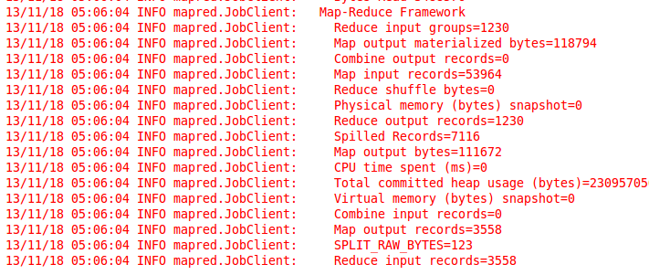
Output 1
First, we run the program on the virtual machine. And we use a relatively small input file called “arora-h-all.”

Slide 6
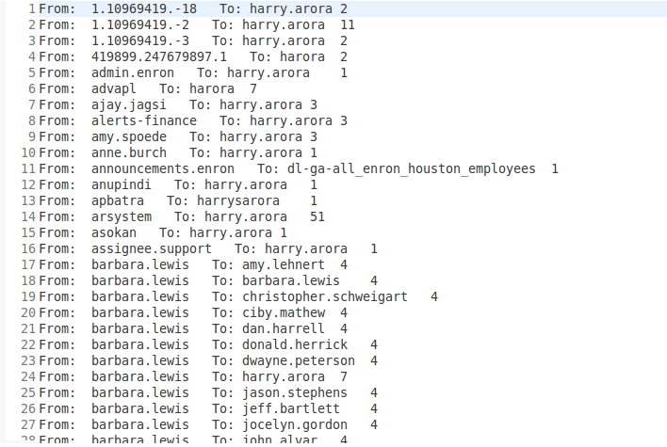
Output 1

Slide 7
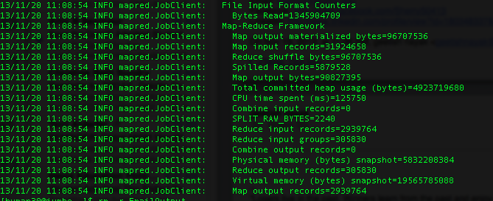
Output 2
Then we used the Enron-all as the input

Slide 8
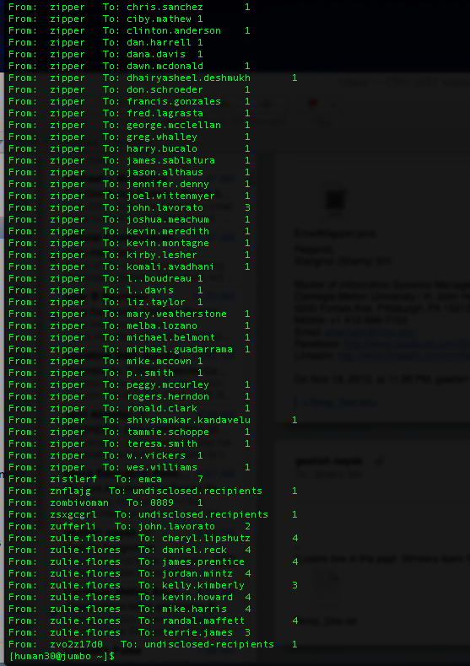
Output 2

Slide 9
Are there any other approaches?
Yes there are other approaches
- Write a custom class which extends RecordReader and implement its abstract methods(initialize() and readNext())
- Create a custom InputFormat which extends FileInputFormat and implement its methods
In this case we didn’t handle “BCC” and “CC” but the logic would be very similar like the way we handled “To”.

